Slide 1
GCN Campaign Performance Analysis

Slide 2
Campaign Summary
3
Number Of Platforms
379
Content pieces
(75 FB, 235 IG 68 TW)
42M
Total Views
(42M IG, 14k FB)
4.8M
Engagements
(4.8M IG, 17K FB, 5k TW)
28M
Campaign Reach
(28M IG, 396K FB)
52M
Campaign Impression
(51.2 M IG, 1.6K FB, 797K TW)

Slide 3
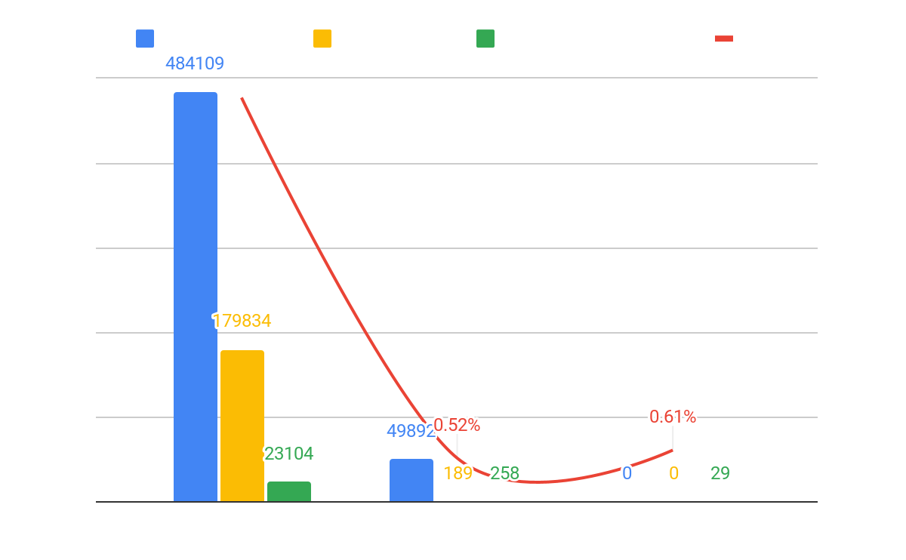
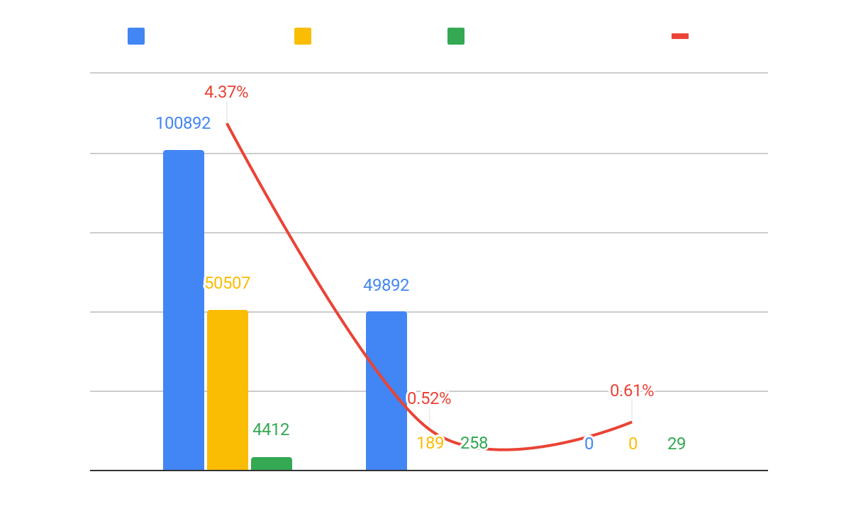
Platform wise Performance
W/ Collaboration
W/o Collaboration
The above charts clearly shows that Instagram outperforms both Facebook and Twitter across all metrics. On the other hand despite having no reach and views, Twitter still manages to outperform Facebook in terms of engagement rate with 0.67%.

Slide 4
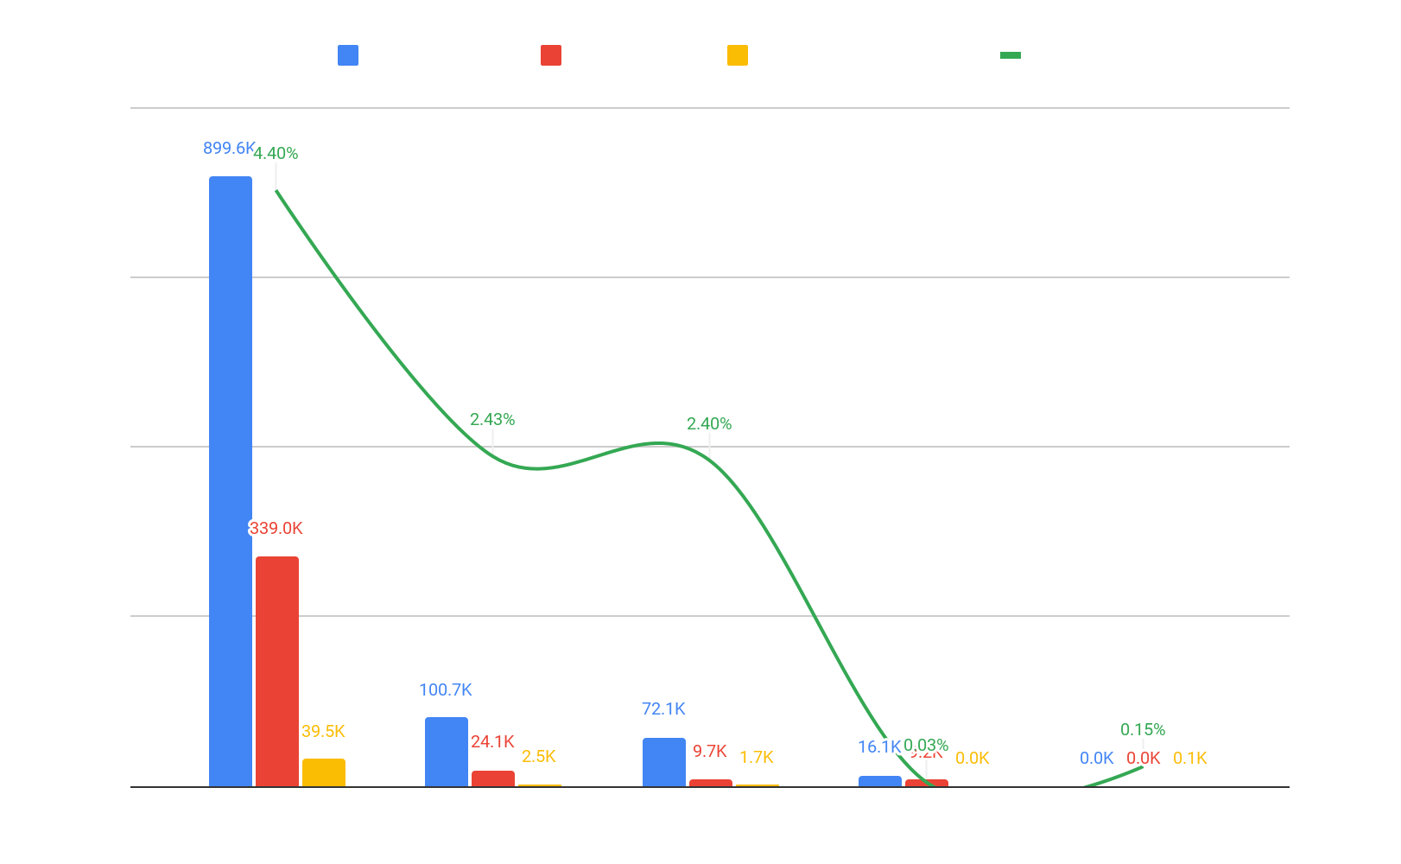
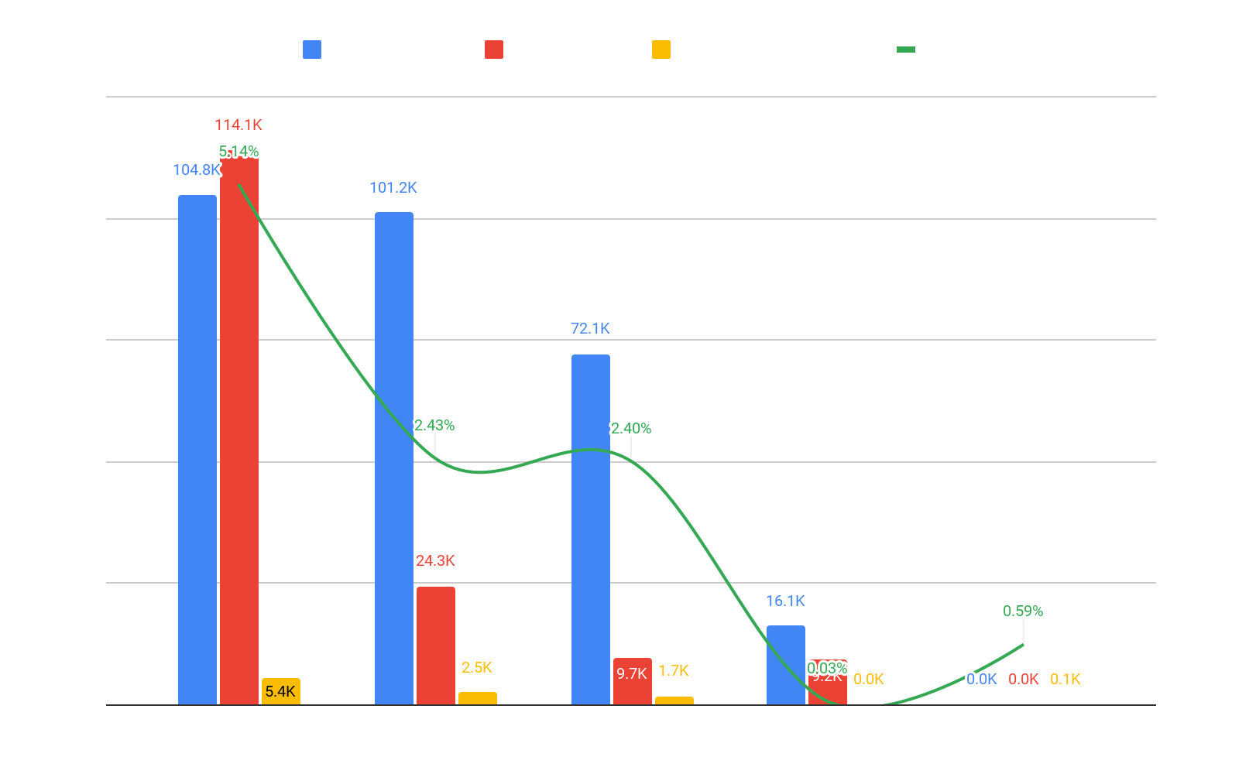
Format wise Performance
W/ Collaboration
W/o Collaboration
Among all the metrics, Reels are the most effective format, while Tweets are performing poorly.
In the left chart Single image posts are not performing as well in other metrics except engagement rate.
But in the right chart it’s almost at par with the reels in case of average views

Slide 5
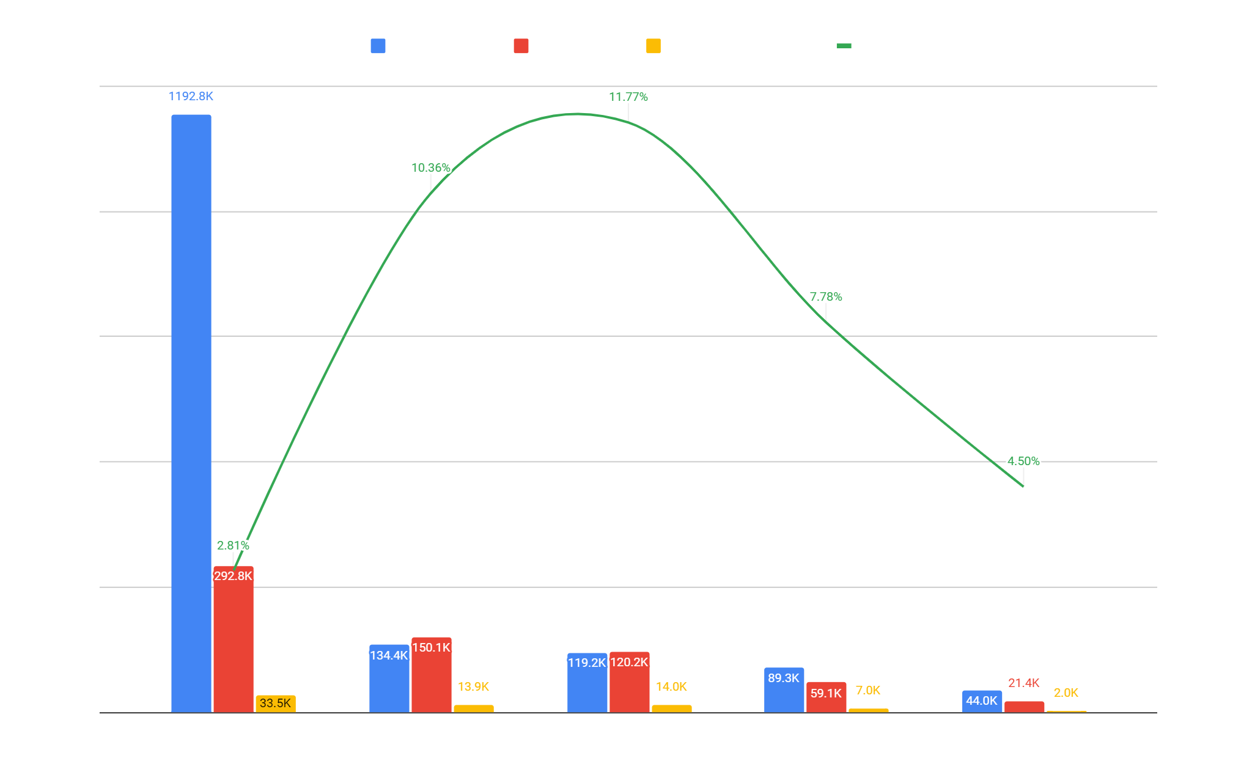
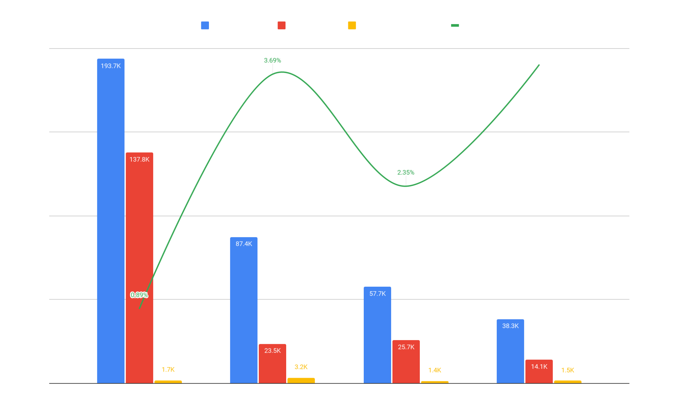
Content Type-Wise Performance
W/ Collaboration
W/o Collaboration
In terms of average reach, average views, and average engagement, sales promotion content is outperforming other types of content in left chart. However, in right chart occasion-specific content has the highest average engagement among all types of content and collection specific content has the highest engagement rate.

Slide 6
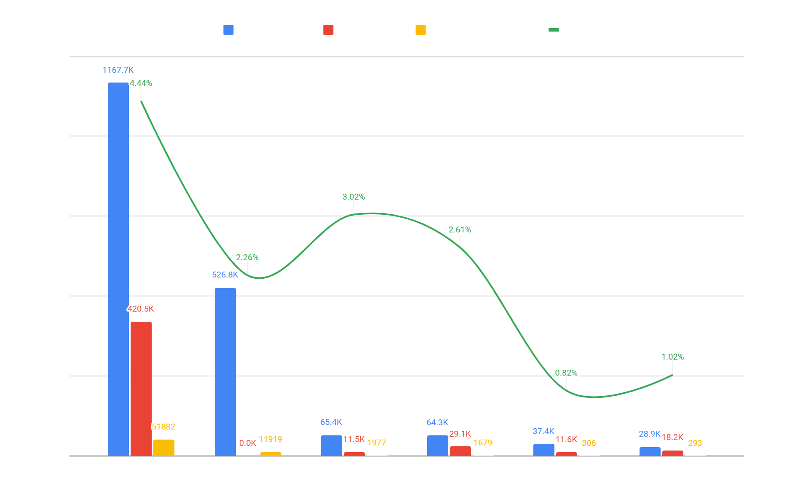
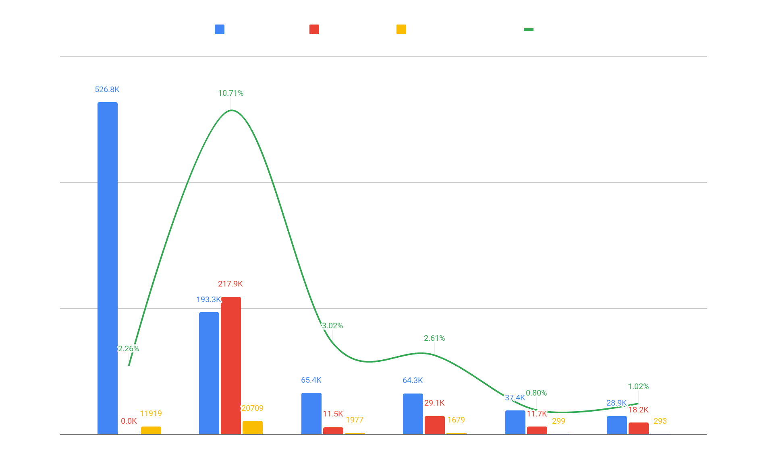
Content bucket wise Performance
W/ Collaboration
W/o Collaboration
The creator reels and collaboration content on the left hand side chart has the highest average reach whereas seasonal content has the highest engagement rate. On the other hand in the right side chart creators reels almost outperforms all the other content buckets

Slide 7
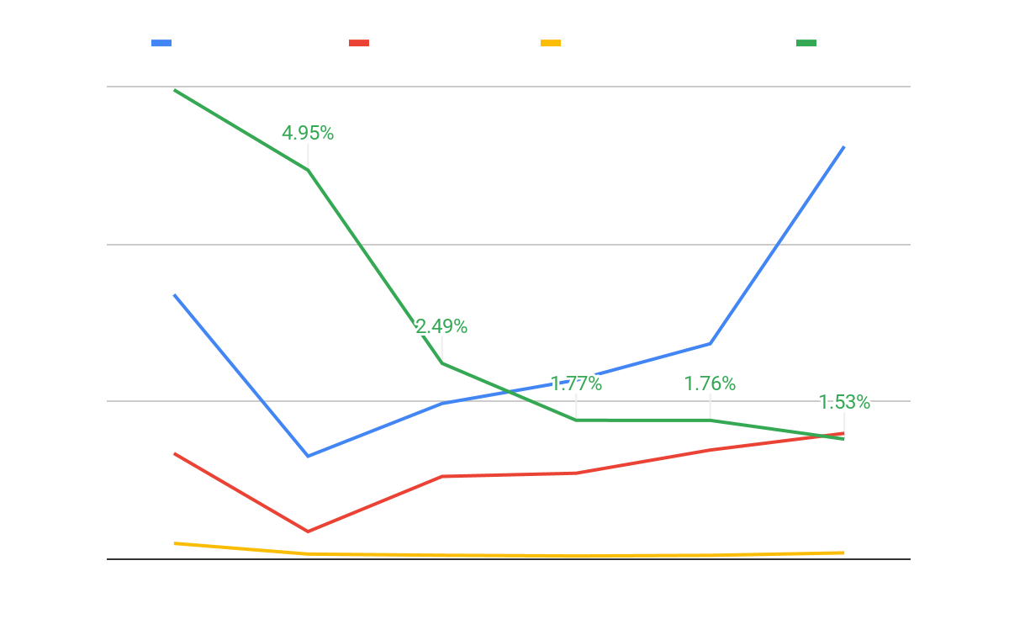
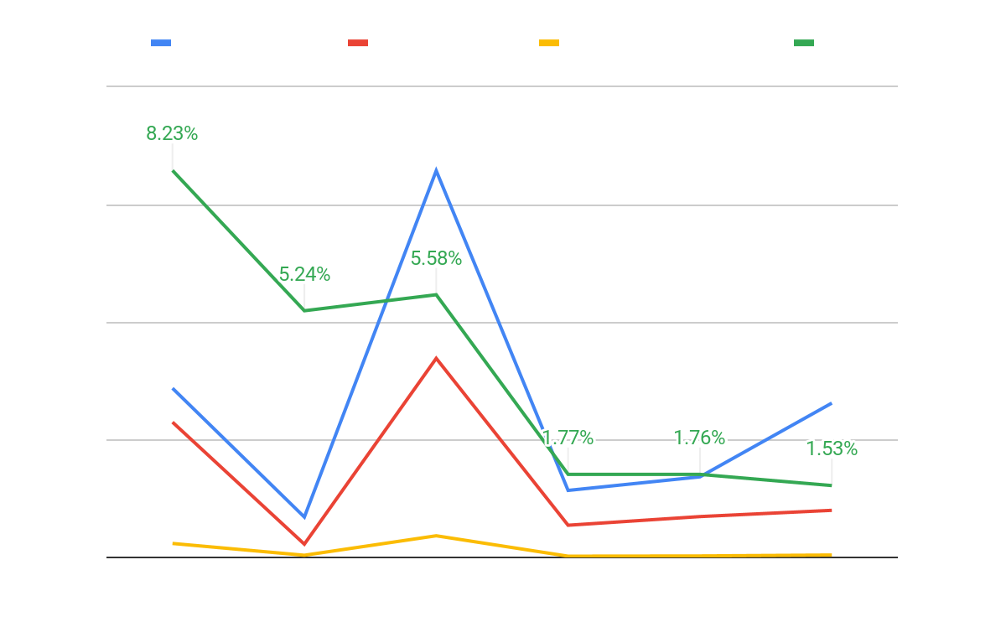
Month wise Performance
W/ Collaboration
W/o Collaboration
The non collaboration contents have a steady growth in terms of all the matrices whereas the Collaboration contents has two major peaks in the months of october and november.
Both types of contents have a steady downfall in terms of ER

Slide 8
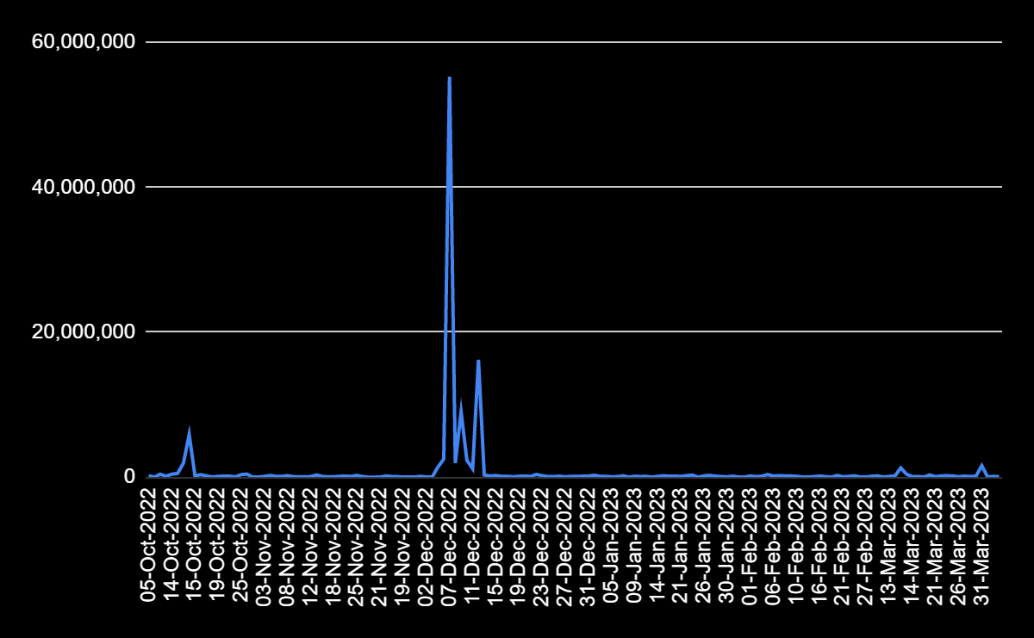
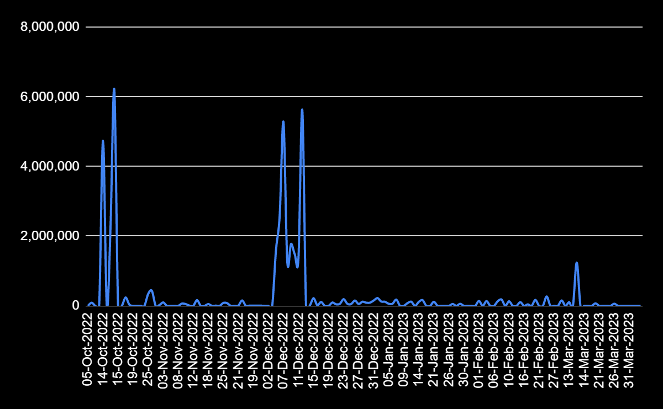
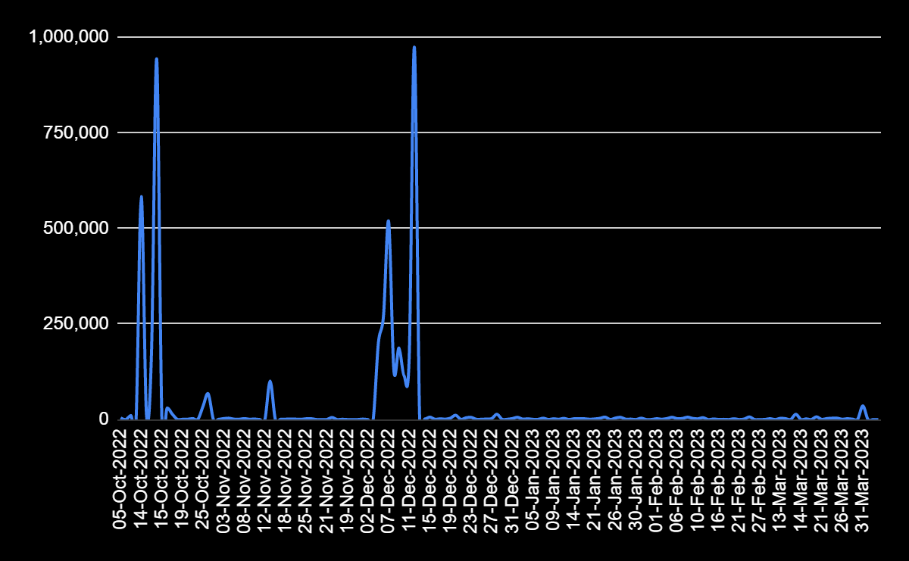
Date wise Performance
Reach
Views
Engagements
The charts display two noticeable peaks which occur in October and December. These spikes can be attributed to the creator collaborations and festive season content.

Slide 9
Best Performing Creators
Reach
Rashami Desai (28M)
Mrunal Thakur (12.6M)
Tanya Sharma (11.7M)
Views
Dolly Singh (4.4M)
Awez Darbar (3.3M)
Engagement
Dolly Singh (765K)
Awez Darbar (442K)
ER
Awez Darbar (95.91%)
Dolly Singh (17.83%)

Slide 10
Key Takeaways
All the metrics suggest that Instagram performs better than Facebook and Twitter.
Collaborating with creators and posting content during festive periods yields excellent results.
By collaborating more with creators who have strong engagement rates, we can improve our own engagement and ensure it remains stable.
Our collaboration with prominent creators like Dolly Singh, Tanya Sharma, Rashami Desai, Mrunal Thakur, and Awez Darbar have resulted in significant gains in terms of reach and engagement.

